Slide 1

Building a Smarter AI-Powered Spam Classifier
NAME : ARUNKUMAR.M
DEPT : BE cse
RE NO: 212921104301
CODE : SJCE2129

Slide 2
Keywords: Spam,emails, extreme learning machine,support vector machine and classification.
Abstract: Spam emails have become an increasing difficulty for the entire web-users.These unsolicited messages waste the resources of network unnecessarily. Customarily, machine learning techniques are adopted for filtering email spams. This article examines the capabilities of the extreme learning machine (ELM) and support vector machine (SVM) for the classification of spam emails with the class level (d). The ELM method is an efficient model based on single layer feed- forward neural network, which can choose weights from hidden layers,randomly. Support vector machine is a strong statistical learning theory used frequently for classification. The performance of ELM has been compared with SVM. The comparative study examines accuracy, precision, recall, false positive and true positive.Moreover, a sensitivity analysis has been performed by ELM and SVM for spam email classification.
Introduction
Recently, the quantity of unwanted bulk email messages, i.e. spam messages has increased in web communication. These unwanted messages are degrading the reliability and authenticity of genuine email messages [1]. Spams have affected the organisations heavily.As a result, the data allocation capacity of the internet is getting difficult, which adds a high financial loss for companies. Many business models depending on the spam commercializing sector, have the advantage as the expense of sending an email needs less cost and can be sent with a large numbers. The above reasons forced few nations to amend some legislative changes [2]. In the literature, two types of spam filter techniques can be found: machine learning and non-machine learning (SMTP) methods. However, machine learning techniques have more popularity than non-machine learning approaches[3]. The subdivision of machine learning strategies can be done further in content based and non-content based. Plenty of research has been carried out on machine learning based spam filters[1][3]. False positives are the main concern as they can take to different implication while filtering spams. Therefore, there might be circumstances, where ham messages may be classified as spams. Though such situations can be rather lessened by the simultaneous application of an amount of dissimilar classification techniques, but it continues to be a matter of debate [4] [5]. In addition to that, the execution of a classifier also depends on the training set. The deportment of the spammer and the type of delivery of spam payload have also produced diverse sets of test emails which need innovative methods to remain operational in spam filtering domain. The majority of the spam filters is developed on the basis of text classification and achieving high accuracy for any spam classification model is a matter of concern. Bayesian method of spam detection is the most popular technique [6]. H. Drucker proposed an excellent support vector machine strategy to filter spams in the year 1999 [7]. Other than machine learning, there exits another approach called SMTP technique (Simple Mail Transfer Protocol) as mentioned earlier [8]. The rout verification, authenticity of the information exchange, and checking of SMTP [9] is managed by SMTP approach. In this work, we adopted two most effective machine learning techniques for spam detection namely: extreme learning machine(ELM) and support vector machine(SVM). Both adopted methods have shown good performance on test email instances.
ELM is considered as the single hidden layer feedforward neural networks(SLFN)[11].The extreme learning machine shows that the neurons, which are hidden can be individually generated

Slide 3
outside of the application. ELM can do classification, also it can be adopted for the approximations [10]. It can make a relationship between neural network, theory of matrix and regression model specially of ridge regression. It has the faster learning rate and an easy implementation process. Also, it needs less intervention from human [11]. Therefore, for large scale data ELM is the potential alternative to other machine learning techniques; it has a large number of activation functions.Also,few piecewise continuous functions can be applied to ELM. The Feedforward neural network is a popular neural network algorithm which can do mappings of complex non-linear functions, but it suffers from the time it takes. ELM overcomes that and can perform better than feedforward neural network. Many authors have worked on the universal approximations of feedforward neural networks.
The adopted second method is support vector machine which is a strong theoretical learning technique that can analyse data and find pattern in the data[12]. The mapping from training input to the high dimensional feature space is done by SVM. It gets the maximum margin of segregation among classes. Application of the SVM and other classification techniques can be found in the literature[13][18][19]. In this work, for both ELM and SVM, accuracy of spam detection, actual vs predicted graphs and confusion matrices are obtained. Also, a solid comparative study has been
carried out for both the methods which has been shown in Table 4 and Table 5.
Data set
In this work, the spam data set namely spambase has been collected from UCI machine learning repository for the experiment purpose[14].ELM technique uses the basic feed-forward neural network for classification and regression [11]. The total number of email instances are 4601.Out of which 1813 are actually spam emails which holds 39.4% of total email instances and remaining 60.6% i.e. 2788 are non-spams. The total number of features is 58, of which 57 attributes are continuous and there exists one titular class label (d). The different type of dataset on spam emails are as follows,
Table 1. Different types of spam corpora[16][17]
Data Set | No of Emails | Spam Emails | Legitimate Emails
PUI | 1099 | 481 | 618
Ling Spam | 2893 | 481 | 2412
U5Spam | 982 | 82 | 90
UCI | 4601 | 1813 | 2788

Slide 4
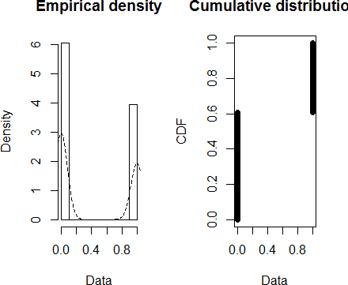
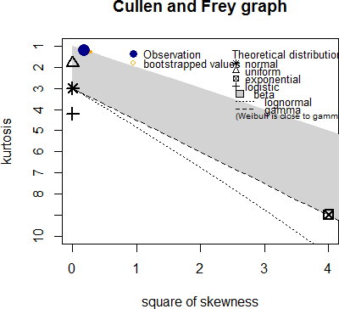
Figure 1. Empirical and Cumulative distribution of data set
Table 2. Statistical output of the data set namely spambase
d | mean | 0.3940448
 | skewness | 0.4338114
 | sd | 0.4886977
 | kurtosis | 1.187404
Figure 2. Cullen and Frey Graph applied to data set

Slide 5
The Extreme Learning Machine Technique of Spam Classification
ELM is considered as the single hidden layer feed-forward neural networks(SLFN)[11]. The association between output t and input x is given as[15].
∑𝐿
𝛽_{𝑖}𝐺(𝑝_{𝑖}𝑥_{j} 𝑞_{𝑖}) = 𝑡_{j}, j = 1 𝑡𝑜 𝑁 (1)
𝑖=1
The number instances is N and nodes in the hidden nodes is L. Here, 𝛽_{𝑖} is the weight of the output parameter. The component (𝑝_{𝑖}, 𝑞_{𝑖}) is the i^{th} limit of the i^{th} hidden node.The input to the ELM is given as L which comprises all the inputs of ‘spambase’ dataset, excluding the decision attribute.The input can be written as x={𝐿} and t is the decision attribute. Equation (1) can be re- written as
𝐻𝛽 = 𝑇 (2)
And the H can be described as,
𝐺⁽𝑝₁𝑥₁𝑞₁⁾ … … … … . . . 𝐺(𝑝_{𝐿}𝑥_{j}𝑞_{𝐿})
… … … … … … . . … … … … … …
𝐻 = [
… … … … … … … … … … … … … .
]
𝐺⁽𝑝₁𝑥_{𝑁}𝑞₁⁾ … … … … … . 𝐺⁽𝑝_{𝐿}𝑥_{𝑁}𝑞_{𝐿}⁾ _{𝑁𝑋𝐿}
_{𝛽}𝑇 _{𝑡}𝑇
𝖥 ¹ ⎤ 𝖥 ¹ ⎤
I . I I . I
𝛽 = _{I} . _{I}
I . I
, 𝑇 = _{I} . _{I}
I . I
⎣𝛽^{𝑇}⎦
⎣𝑡^{𝑇} ⎦
^{𝐿} 𝐿𝑋𝑀
^{𝑁} 𝑁𝑋𝑚
From the equation (3) the value of 𝛽 can be calculated,
𝛽 = 𝐻⁻¹𝑇 (3)
In the below, several graphs have been shown of false positive vs true positive, precision vs recall and specificity vs sensivity when ELM is applied to the test spam email. These graphs are shown to examine the performance of adopted ELM in figures 3, 4 and 5.The definition of accuracy,precision,recall,positive predicted values,negative predicted values, McNemar test(P value),
Accuracy=
𝑇𝑃+𝑇𝑁
𝑇𝑃+𝑇𝑁+𝐹𝑃+𝐹𝑁
Precision=
𝑇𝑃
,
𝑇𝑃+𝐹𝑃
Recall=
𝑇𝑃
.
𝑇𝑃+𝐹𝑁
Positive predictive value= ^{𝑇𝑃}
𝑇𝑃+𝐹𝑃
Negative predictive value=
𝑇𝑁
𝑇𝑁+𝐹𝑁
McNemar test(P value):
_{χ2=}(𝑓−g),
f is the outcome of first positive test and second negative test
(𝑓+g)
and g is the outcome of first negative test and second positive test. The detailed comparisons between ELM and SVM has been shown in Table 4 and Table 5 ,where all the above parameters’ values have been obtained.

Slide 6
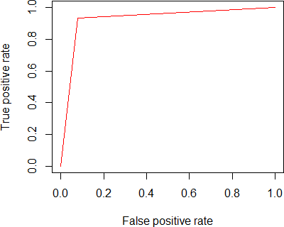
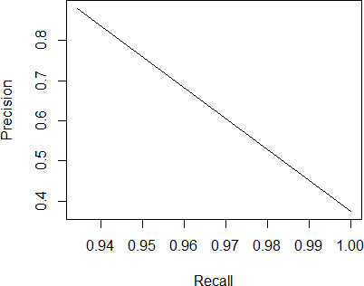
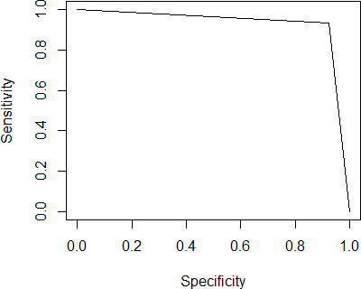
Figure 3. False positive vs True positive
Figure 4. Precision vs Recall
Figure 5. Specificity vs Sensivity

Slide 7
The Support Vector Machine Technique of Spam Classification
Support vector machine is a strong statistical learning theory used frequently for classification of data.SVM has been introduced by vapnik [11] and attaining popularity for its attractive features. In this work, the spam email classification has been limited by two classes : spam and non-spam.The data set is having the training vector S consisting two different classes that are spam or ham,
𝑆 = {⁽𝑥¹, 𝑦¹⁾ … … (𝑥^{𝑛}, 𝑦^{𝑛}), where 𝑥 ∈ 𝑅^{𝑛}, 𝑦 ∈ {−1, +1} (4)
Where, 𝑥 ∈ 𝑅^{𝑛}, is a vector which has dimension n, with every instance either belongs to spam or non-spam(ham). In this work, our intention is to discover a generalized type of classifier that can separate two classes, i.e spam and non-spam {-1,+1} given the train data set.The distinguisher is nothing but a linear plane of the form,
𝑓⁽𝑥⁾ = w. 𝑥 + 𝑘 = 0, (5)
Where, w is the weight to segregate the hyperplane and k∈ 𝑅 is a bias. In this work the hyper planes correspond to spam emails and non-spam emails can be written as,
w. 𝑥_{𝑖} + 𝑘 ≥ 1, ⁽𝑓𝑜𝑟 𝑦_{𝑖} = 1⁾
w. 𝑥_{𝑖} + 𝑘 ≤ −1, ⁽𝑓𝑜𝑟 𝑦_{𝑖} = −1⁾
Equation (6) & (7) can be combined together as,
𝑦_{𝑖}⁽w. 𝑥_{𝑖} + 𝑘⁾ ≥ 1
(6)
(7)
(8)
The slack variable is many times added equation (11) can be updated as,
𝑦_{𝑖}⁽w. 𝑥_{𝑖} + 𝑘⁾ ≥ 1 − 𝜉_{𝑖}
to adjust the miss classification rate, therefore
For, spam class, the perpendicular distance from source to the hyperplane
w. 𝑥_{𝑖} + 𝑘 = 1, is
(9)
^{|k−1|}, and for non-spam class the hyper plane can be written as,
||w||
w. 𝑥_{𝑖} + 𝑘 = −1 and the perpendicular distance can be written as, ^{|k+1|}.
Moreover the margin, 𝜌(w, 𝑘) between the plane can be given as,
||w||
𝜌(w,k)= ²
(10)
||w||
To maximize this margin the following optimization problem forms,
Minimize ¹ ||w||² + 𝐶 ^{∑𝑙} 𝜉_{𝑖}
(11)
2
C is the capacity factor.
𝑖=𝑙
Table 3 . Detail outputs obtained by SVM
SVM
parameter | epsilon = 0.1 cost C = 5
Kernel | Gaussian Radial Basis kernel function.
sigma | 0.05
Number of Support Vectors | 2264
Objective Function Value | -1757.389
Training error | 0.081035
Cross validation error | 0.066512

Slide 8
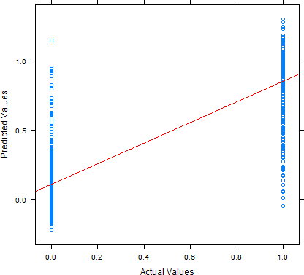
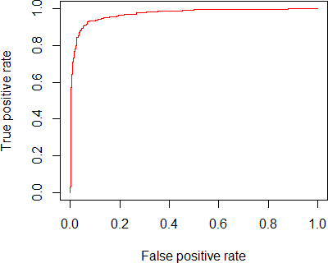
Below are the graphs (figures 6,7,8 and 9) which show the actual vs predicted plot,false positive vs true positive,precision vs recall and sensitivity vs specificity and accuracy plots once applied to test spam emails.
Figure 6 . Actual vs Predicted
Figure 7. False positive vs True positive

Slide 9
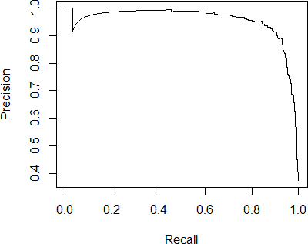
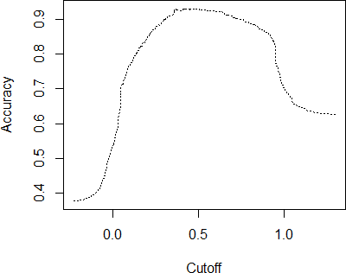
Figure 8. Precision vs Recall
Figure 9. Accuracy graph with cut-offs
Simulations Results and Comparative Study of ELM and SVM
The following table(Table 4) examines the performance of ELM and SVM by obtaining the values accuracy,CI,kappa, Mcnemar's Test( P-Value), information rate, sensitivity,specificity, positive pre diction value , negative prediction value, prevalence , detection rate , detection prevalence,balanced detection and balanced accuracy .
Table 4. Detailed comparisons of ELM and SVM
 | ELM | SVM
Accuracy | 0.9273 | 0.9217
95% CI | (0.9087, 0.9431) | (0.91, 0.9324)
Kappa | 0.8468 | 0.8353
Mcnemar's Test P-Value | 0.01088 | 1.21e-07
No Information Rate | 0.6246 | 0.597
P-Value [Acc > NIR] | < 2e-16 | < 2.2e-16
Sensitivity | 0.9229 | 0.9607
Specificity | 0.9345 | 0.8641
Pos Pred Value | 0.9591 | 0.9128

Slide 10
Neg Pred Value | 0.8794 | 0.9368
Prevalence | 0.6246 | 0.5970
Detection Rate | 0.5765 | 0.5735
Detection Prevalence | 0.6011 | 0.6283
Balanced Accuracy | 0.9287 | 0.9124
Also, the adopted models have been able to find the confusion matrices for both ELM and SVM which has been shown below in Table 5.
Table 5. Confusion Matrices of ELM and SVM
 | Prediction | nonspam | spam
ELM | nonspam | 539 | 23
 | spam | 45 | 328
SVM | nonspam | 1319 | 126
 | spam | 54 | 801
Conclusion
This article inspects the capability of ELM and SVM for classification of spam email. The adopted ELM and SVM classify emails based on class level (d). The performances of ELM and SVM are inspiring as they both have achieved high accuracy rate in spam email detection. The performance of ELM has been compared with SVM. The comparative study examines accuracy, precision, recall, false positive, true positive and a sensitivity analysis of ELM and SVM for spam email classification.The experimental results establish the effectiveness and efficiency of the ELM and SVM models. So this article sums up that ELM and SVM, can be used for solving different classification problems in computer engineering.
References
B. Zhou, Y. Yao,J. Luo Cost-sensitive three-way email spam filtering, Journal of Intelligent Information Systems, Vol. 42,No.1, pp. 19-45, (2014).
D. MochrieCanada’s Anti-spam/anti-spyware: An Overview’. Internationa Journal of Franchising Law, Vol. 12, No. 4, (2014) .
T. A Almeida, J.M.G Hidalgo and A.Yamakami Contributions to the study of SMS spam filtering: new collection and results’,In Proceedings of the 11th ACM symposium on Document engineering ,pp. 259-262, (2011).
Y. Meng and L. F Kwok Enhancing email classification using data reduction and disagreement- based semi-supervised learning. In Communications (ICC), 2014 IEEE International Conference on,pp. 622-627, (2014).
S. S Roy,S. Charaborty,S. Sourav, and A. Abraham Rough set theory approach for filtering spams from boundary messages in a chat system. In Intelligent Systems Design and Applications (ISDA), 2013 13th International Conference on (pp. 28-34). IEEE, (2013).
M. Sahami,S. Dumais, D. Heckerman,E. Horvitz, E A Bayesian approach to filtering junk e- mail’. In Learning for Text Categorization: Papers from the 1998 workshop ,Vol. 62, pp. 98-105, (1998).

Slide 11
International Journal of Engineering Research in Africa Vol. 22
161
H. Drucker, S. Wu and V.N Vapnik Support vector machines for spam categorization’,Neural Networks, IEEE Transactions on, Vol 10,No. 5,pp.1048-1054, (1999)
E. Blanzieri and A. Bryl A survey of learning-based techniques of email spam filtering, Artificial Intelligence Review, Vol.29,No.1, pp.63-92, (2008).
G. Caruana ,M. Li A survey of emerging approaches to spam filtering’,ACM Computing Surveys (CSUR), Vol 44,No.2,pp. 9, (2012).
E. Cambria,G.B Huang, L . L.C Kasun,H. Zhou,C.M Vong,J. Lin, J. Liu. Extreme learning machines [trends & controversies]. Intelligent Systems, IEEE, 28(6), 30-59, (2013).
G. B Huang,Q.Y Zhu,C.K Siew Extreme learning machine: theory and applications. Neurocomputing, 70(1), 489-501, (2006).
C. Cortes ,V. Vapnik Support-vector networks. Machine learning, 20(3), 273-297, (1995).
A.Basu,S.S. Roy and A. Abraham A Novel Diagnostic Approach Based on Support Vector Machine with Linear Kernel for Classifying the Erythemato-Squamous Disease. In Computing Communication Control and Automation (ICCUBEA), 2015 International Conference on (pp. 343- 347). IEEE, (2015).
M. Hopkins, E. Reeber,G. Forman,J. Suermondt Spambase, UML Repository, ed, (1999).
R. Viswanathan ,Pijush Samui Determination of rock depth using artificial intelligence techniques.Geoscience Frontiers, (2015).
J. Clark, I. Koprinska and J. Poon A neural network based approach to automated e-mail classification. In null ,p. 702. IEEE, (2003).
M. Lichman UCI Machine Learning Repository [http://archive.ics.uci.edu/ml]. Irvine, CA: University of California, School of Information and Computer Science, (2013).
S.S.Roy, V.M Viswanatham,P.V. Krishna,N. Saraf,A. Gupta and R Mishra Applicability of Rough Set Technique for Data Investigation and Optimization of Intrusion Detection System. In Quality, Reliability, Security and Robustness in Heterogeneous Networks , pp. 479-484, Springer Berlin Heidelberg, (2013).
S.S.Roy , D. Mittal, A. Basu, and A. Abraham Stock Market Forecasting Using LASSO Linear Regression Model In Afro-European Conference for Industrial Advancement, pp. 371-381, Springer International Publishing, (2015).

Slide 12
International Journal of Engineering Research in Africa Vol. 22
10.4028/www.scientific.net/JERA.22
Classifying Spam Emails Using Artificial Intelligent Techniques
10.4028/www.scientific.net/JERA.22.152
DOI References
[1] B. Zhou, Y. Yao,J. Luo Cost-sensitive three-way email spam filtering, Journal of Intelligent Information Systems, Vol. 42, No. 1, pp.19-45, (2014).
10.1007/s10844-013-0254-7
T. A Almeida, J.M. G Hidalgo and A. Yamakami Contributions to the study of SMS spam filtering: new collection and results', In Proceedings of the 11th ACM symposium on Document engineering , pp.259-262, (2011).
10.1145/2034691.2034742
Y. Meng and L. F Kwok Enhancing email classification using data reduction and disagreementbased semi-supervised learning. In Communications (ICC), 2014 IEEE International Conference on, pp.622-627, (2014).
10.1109/icc.2014.6883388
S. S Roy,S. Charaborty,S. Sourav, and A. Abraham Rough set theory approach for filtering spams from boundary messages in a chat system. In Intelligent Systems Design and Applications (ISDA), 2013 13th International Conference on (pp.28-34). IEEE, (2013).
10.1109/isda.2013.6920763
H. Drucker, S. Wu and V. N Vapnik Support vector machines for spam categorization', Neural Networks, IEEE Transactions on, Vol 10, No. 5, pp.1048-1054, (1999).
10.1109/72.788645
E. Blanzieri and A. Bryl A survey of learning-based techniques of email spam filtering, Artificial Intelligence Review, Vol. 29, No. 1, pp.63-92, (2008).
10.1007/s10462-009-9109-6
G. Caruana ,M. Li A survey of emerging approaches to spam filtering', ACM Computing Surveys (CSUR), Vol 44, No. 2, p.9, (2012).
10.1145/2089125.2089129
E. Cambria,G. B Huang, L . L. C Kasun,H. Zhou,C. M Vong,J. Lin, J. Liu. Extreme learning machines [trends & controversies]. Intelligent Systems, IEEE, 28(6), 30-59, (2013).
10.1109/mis.2013.140
G. B Huang,Q. Y Zhu,C. K Siew Extreme learning machine: theory and applications. Neurocomputing, 70(1), 489-501, (2006).
10.1016/j.neucom.2005.12.126
[13] A. Basu S.S. Roy and A. Abraham A Novel Diagnostic Approach Based on Support Vector Machine with Linear Kernel for Classifying the Erythemato-Squamous Disease. In Computing Communication Control and Automation (ICCUBEA), 2015 International Conference on (pp.343-347). IEEE, (2015). 10.1109/iccubea.2015.72
[15] R. Viswanathan , Pijush Samui Determination of rock depth using artificial intelligence techniques. Geoscience Frontiers, (2015).
10.1016/j.gsf.2015.04.002
[16] J. Clark, I. Koprinska and J. Poon A neural network based approach to automated e-mail classification.

Slide 13
In null , p.702. IEEE, (2003). 10.1109/wi.2003.1241300
S.S. Roy, V. M Viswanatham P.V. Krishna,N. Saraf,A. Gupta and R Mishra Applicability of Rough Set Technique for Data Investigation and Optimization of Intrusion Detection System. In Quality, Reliability, Security and Robustness in Heterogeneous Networks , pp.479-484, Springer Berlin Heidelberg, (2013). 10.1007/978-3-642-37949-9_42
S.S. Roy , D. Mittal, A. Basu, and A. Abraham Stock Market Forecasting Using LASSO Linear Regression Model In Afro-European Conference for Industrial Advancement, pp.371-381, Springer International Publishing, (2015).
10.1007/978-3-319-13572-4_31
View publication stats

Slide 14
THANK YOU!

